Slide 1


Slide 2

Python Programming Bootcamp - Week 5, Day 01
Introduction to APIs
Atta Muhammad
attapanhyar@quest.edu.pk
+923331971110
Quaid-e-Awam University of Engineering, Science and Technology

Slide 3
Learning Outcomes
Understand the concept of APIs and how they work.
Install and use Python's requests library for HTTP requests.
Handle and parse JSON responses from APIs.
Integrate data from public APIs into Python projects.

Slide 4
What is an API?
Definition: Application Programming Interface (API)
APIs are mechanisms that enable two software components to communicate with each other using a set of definitions and protocols.
Examples: Social media integrations, weather data, payment gateways.

Slide 5
Types of APIs
Web APIs: Communicate over HTTP
REST vs. SOAP: REST (Representational State Transfer) is simpler and more lightweight.
Public vs. Private APIs: Public APIs are open, while private APIs require authentication.

Slide 6
Real-World API Examples
Weather Data: OpenWeather API
Social Media Data: Twitter API
Financial Data: Exchange rates API

Slide 7
Installing the requests Library
Command: pip install requests
Usage of the requests library for making HTTP requests.

Slide 8

Making a Simple GET Request
Example Code: Fetching data from GitHub's public API

Slide 9
Checking Response Status
HTTP Status Codes:
200 OK
404 Not Found
500 Internal Server Error

Slide 10
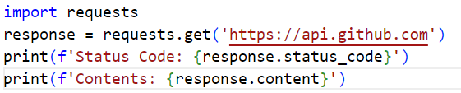
Accessing Response Content

Slide 11
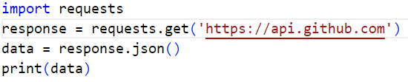
Converting Response to JSON

Slide 12
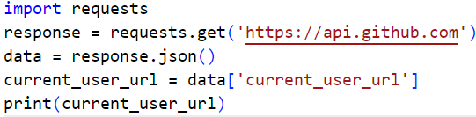
Extracting Specific Data
Example: Extract the current_user_url from GitHub’s API.

Slide 13
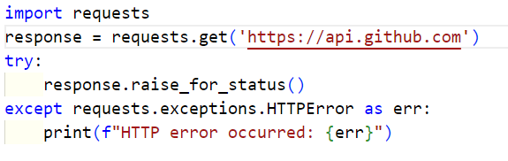
Handling HTTP Errors
Using try-except blocks to handle errors

Slide 14
Query Parameters in API Requests
Adding parameters to refine API requests.
Example: Searching for users on GitHub.

Slide 15
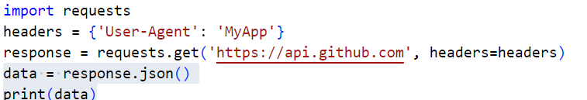
Using Headers in API Requests

Slide 16
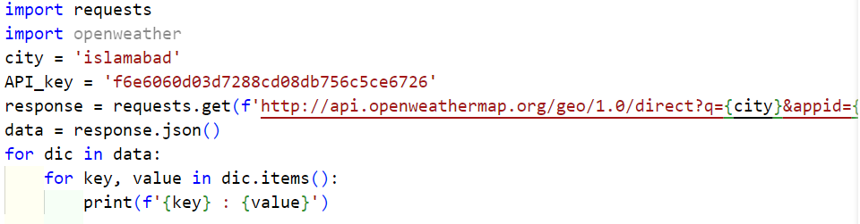
Fetching Weather Data from an API
Example: Fetching weather data for a city using the OpenWeather API.

Slide 17
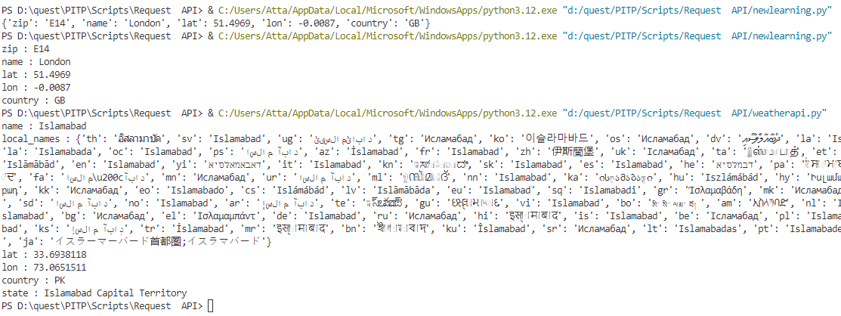

Slide 18
Sample Project

Slide 19

Questions ?

